Slide 1
Anaconda & Docker
Guozikun

Slide 2

1. Introduction
Conda is an open source package management system and environment management system that runs on Windows, macOS and Linux. Conda quickly installs, runs and updates packages and their dependencies. Conda easily creates, saves, loads and switches between environments on your local computer. It was created for Python programs, but it can package and distribute software for any language.

Slide 3
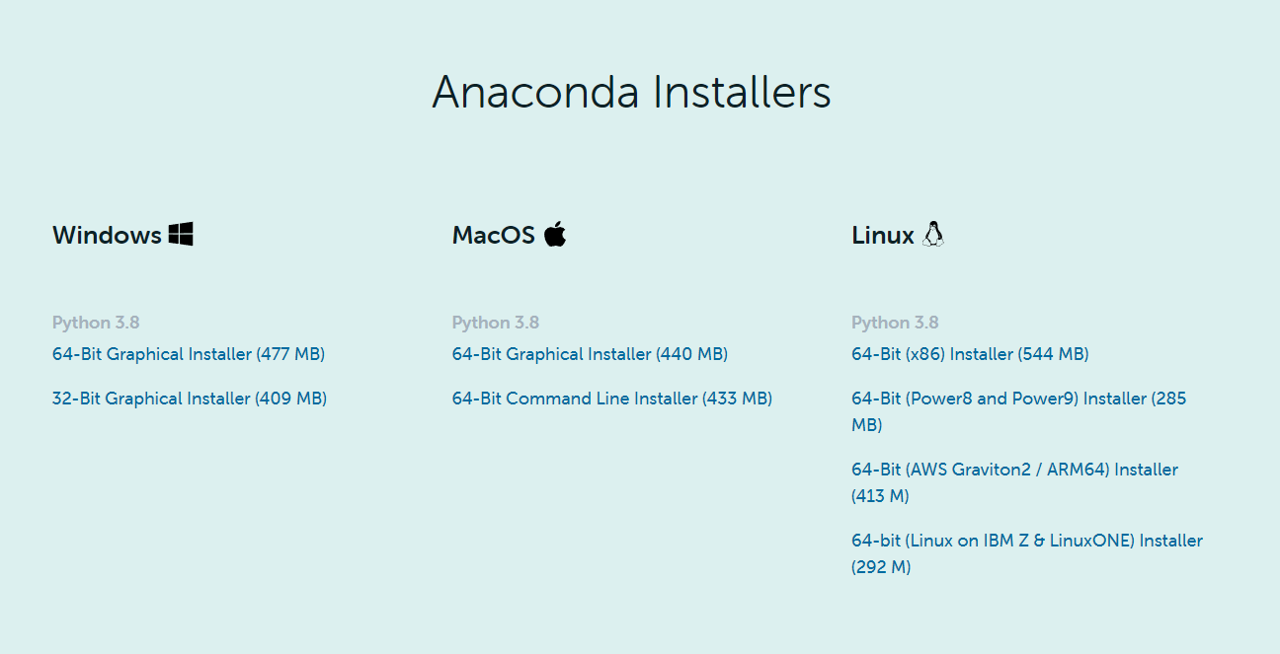
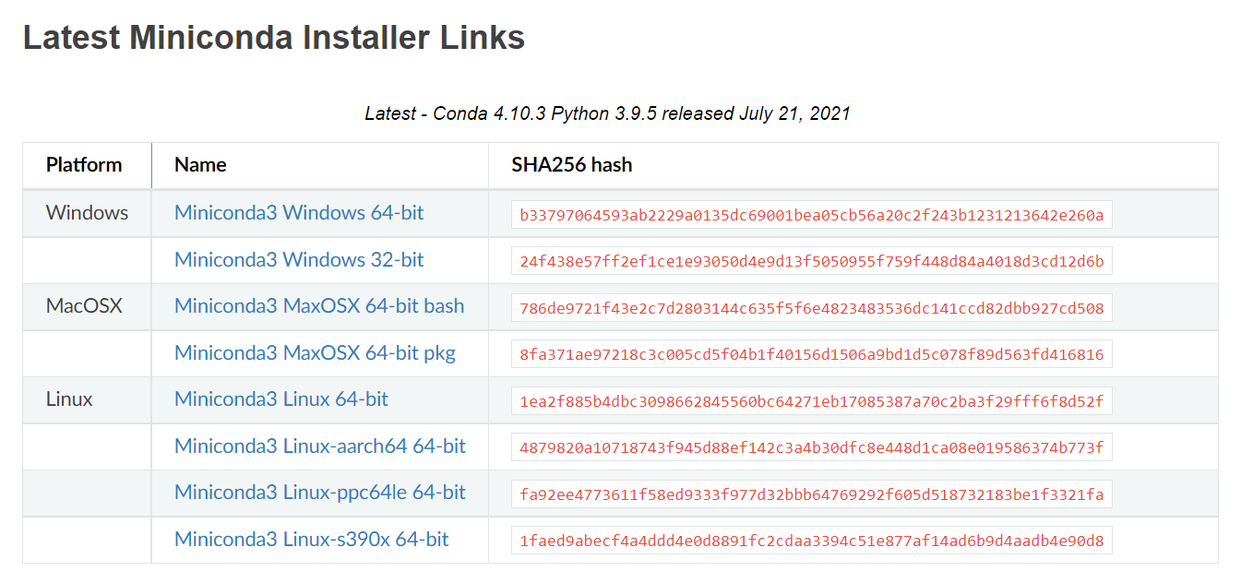
2.Install Conda
https://www.anaconda.com/products/individual#Downloads
https://docs.conda.io/projects/conda/en/latest/user-guide/install/

Slide 4
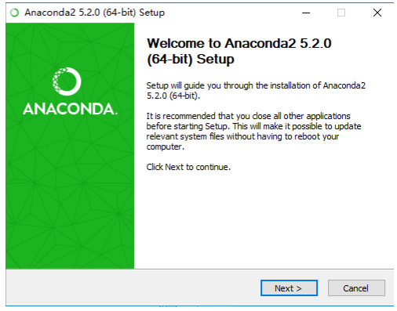
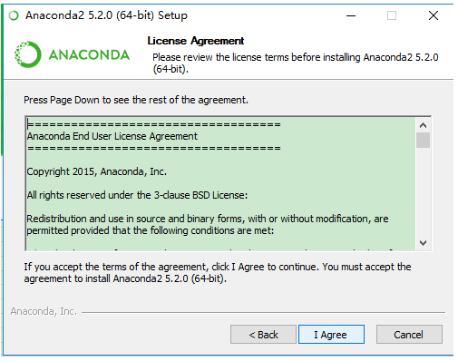
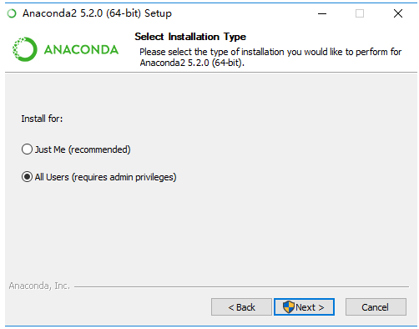
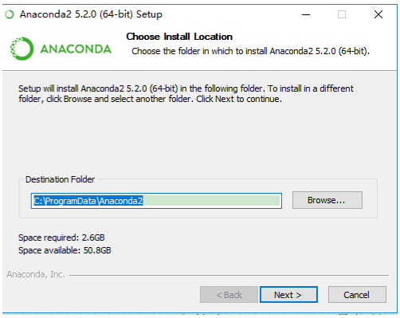
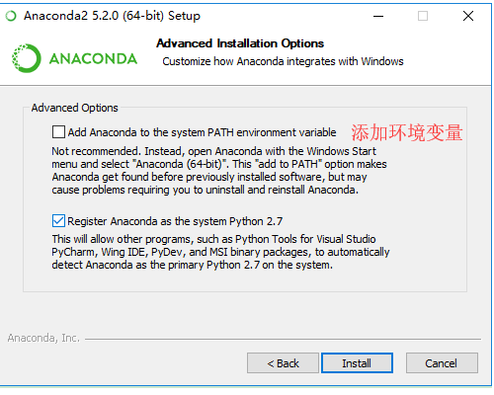
2.Install Conda

Slide 5
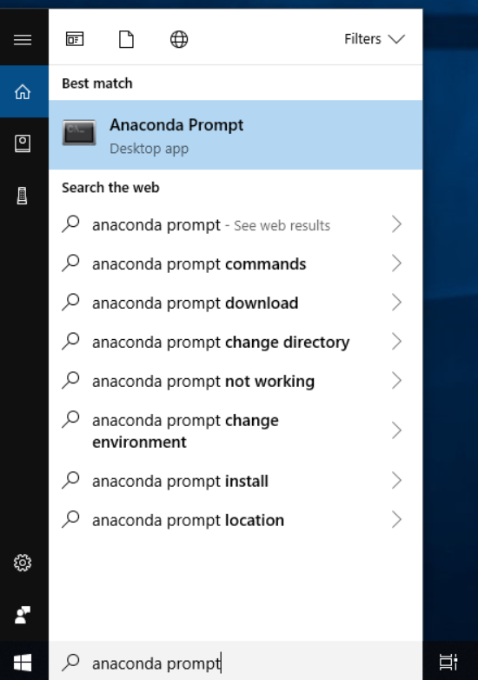
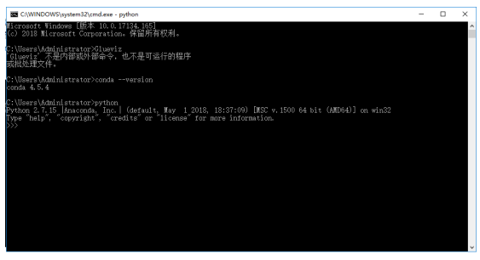
2. Manage virtual environments
activate
Anaconda Prompt

Slide 6
3.Conda cmd
View all command help for environmental management conda --help
Create the environment conda create --name your_env_name
Create an environment that contains certain packages conda create --name your_env_name numpy scipy
List all current environments conda info --envs
Enter an environment activate your_env_name
…..
https://docs.conda.io/projects/conda/en/latest/user-guide/concepts/conda-commands.html

Slide 7
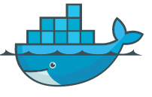
Introduction
Docker is an open source application container engine
Docker allows developers to package their applications and dependencies into a lightweight, portable container, and then publish it to any popular Linux machine, and it can also be virtualized.
Containers use the sandbox mechanism completely, and there will not be any interfaces between each other, and more importantly, the container performance overhead is extremely low.

Slide 8
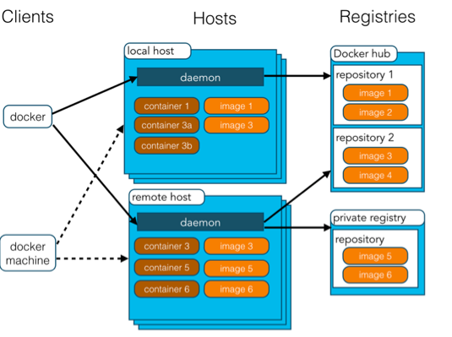
Docker architecture
Docker architecture
Docker includes three basic concepts:
Image: Docker image is equivalent to a root file system.
Container: instance of image
Repository:Save image

Slide 9
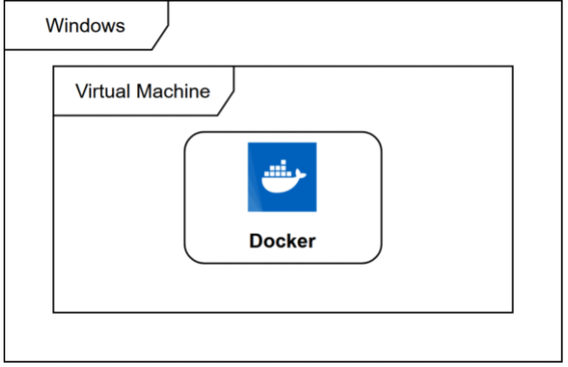
Docker installation
Docker is not a general-purpose container tool, it relies on the existing and running Linux kernel environment.
Docker essentially creates an isolated file environment under the already running Linux, so its execution efficiency is almost equal to the deployed Linux host.
Therefore, Docker must be deployed on the Linux kernel system. If other systems want to deploy Docker, they must install a virtual Linux environment
https://hub.docker.com/editions/community/docker-ce-desktop-windows

Slide 10

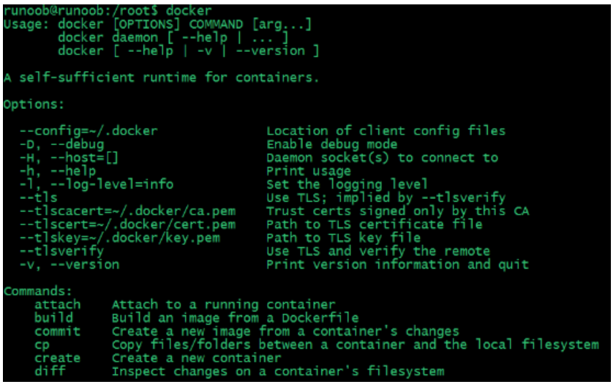
Docker Hello World
Parameter analysis:
docker: Docker binary executable file.
run: Combine with the previous docker to run a container.
ubuntu:15.10 Specify the image to be run. Docker first checks whether the image exists on the local host. If it does not exist, Docker will download the public image from the mirror repository Docker Hub.
/bin/echo "Hello world": The command executed in the started container

Slide 11


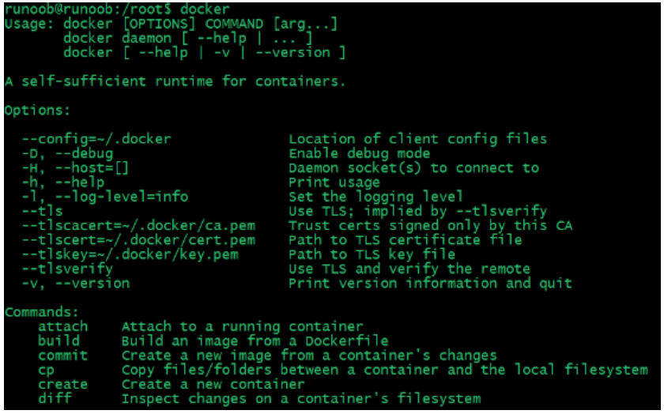
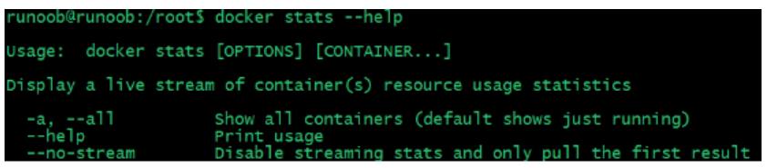
Docker container usage
Enter the docker command to view all the command options of the Docker client.

Slide 12
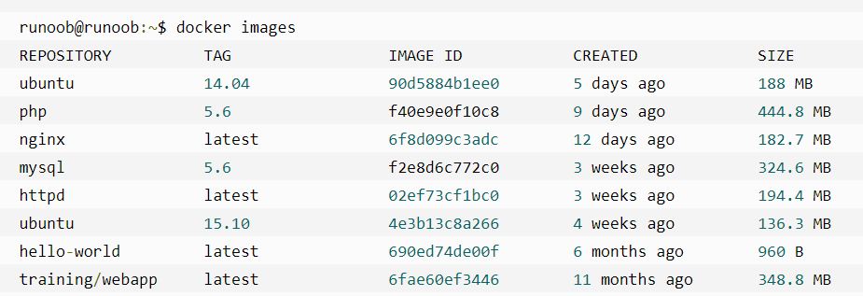
Docker image usage
REPOSITORY: indicates the source of the mirrored warehouse
TAG: Mirrored tag
IMAGE ID: Image ID
CREATED: Mirror creation time
SIZE: image size
Manage and use local Docker host image
Create a image
List the image list

Slide 13
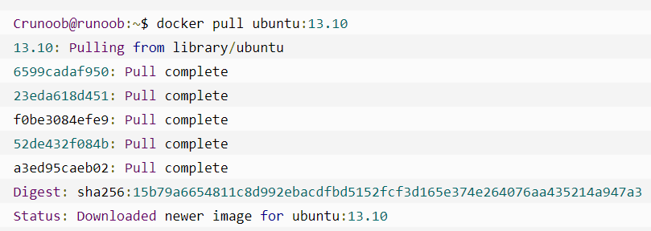
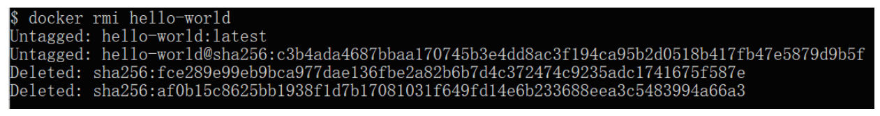
Docker image usage
Pre-download image
Delete image

Slide 14

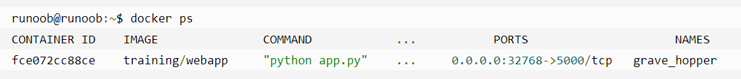
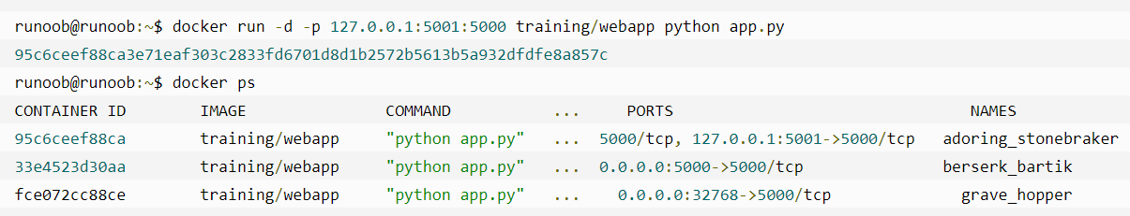
Docker container connection
Network port mapping

Slide 15
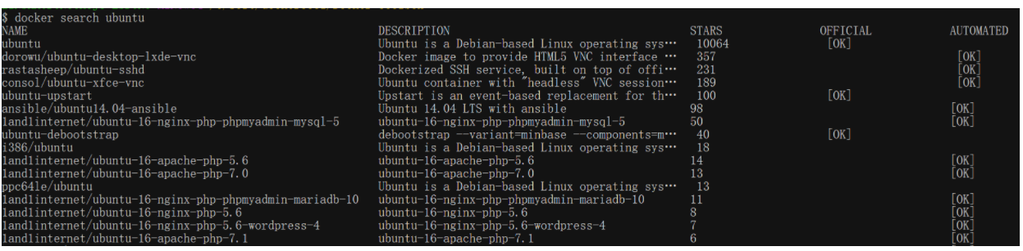
Docker repository management
Docker Hub
Register a Docker account for free at https://hub.docker.com.
Find the remote repository and download it locally

Slide 16
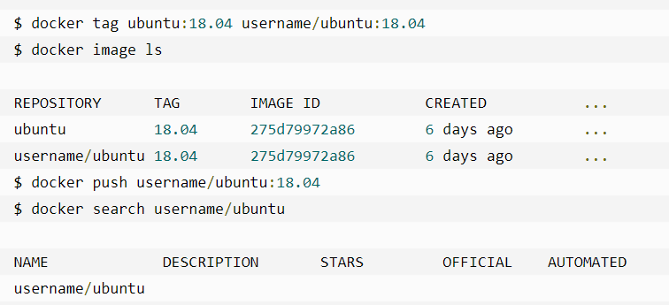
Docker repository management
Push image

